Slide 1
FEDERATED LEARNING-BASED 3D MEDICAL IMAGE COMPRESSION

Slide 2
Problem Statement
Problem Statement
With the growing size and volume of 3D medical imaging data (e.g., MRI, CT scans), efficient compression methods are critical. However, traditional centralized learning models pose privacy risks and require data sharing, which is not feasible in many healthcare settings. There is a need for a privacy-preserving, collaborative compression approach that works across institutions without compromising data security.
Problem Description
Medical institutions generate large amounts of 3D image data, which is costly to store and transmit. Conventional image compression models require access to raw data, violating patient privacy and regulatory policies (e.g., HIPAA). Federated Learning (FL) enables decentralized training of AI models without sharing raw data. This project proposes using FL to collaboratively train a neural network for efficient 3D image compression while ensuring data privacy and compliance.

Slide 3
Abstract
This project proposes a novel federated learning-based framework for compressing 3D medical images in a privacy-preserving, decentralized manner. Instead of pooling patient data in a central location, individual hospitals train a local compression model and share only the model updates. These updates are aggregated to build a global model that learns effective compression patterns across diverse datasets without exposing raw images. The system utilizes neural network-based compression techniques, such as autoencoders or 3D CNNs, and evaluates performance using metrics like compression ratio, PSNR, and SSIM. This approach enhances data security, reduces storage and transmission costs, and maintains diagnostic quality across distributed healthcare environments.

Slide 4
Literature Survey
Traditional Compression Techniques
JPEG2000, PNG, and H.264 offer lossless/lossy compression but aren't optimized for 3D volumes or medical image quality.
Neural Network-Based Compression
Autoencoders and Variational Autoencoders (VAEs) have shown promise in compressing image data while retaining semantic content.
Federated Learning (FL)
Introduced by Google, FL enables collaborative model training without centralizing data, ideal for sensitive domains like healthcare.
Recent Research
Studies show FL applied to 2D medical imaging tasks (segmentation, classification) with success, but 3D image compression remains underexplored.

Slide 5
Existing Systems
Centralized Deep Learning Compression Requires uploading large medical images to central servers, raising privacy concerns.
Traditional Compression Tools Inefficient for 3D volumetric data and lack context-aware encoding.
Cloud-Based Storage Solutions Offer convenience but risk data leaks without strong privacy guarantees.
Federated Learning in Imaging Applied mainly for diagnosis, not yet widely explored for 3D image compression.

Slide 6
Limitations
Traditional Compression: Not optimized for volumetric medical data.
Centralized AI Models: Pose privacy and regulatory concerns (e.g., HIPAA compliance).
Data Transfer Bottlenecks: High cost and latency in transmitting large datasets.
Lack of Personalization: Generic models may not adapt to institution-specific data.

Slide 7
Advantages
Data Privacy Preserved: No need to transmit patient data; compliant with medical regulations.
Collaborative Model Training: Improves model performance by learning from diverse sources.
Efficient Compression: High compression ratio with minimal loss of diagnostic information.
Scalable Across Institutions: Supports multi-hospital and multi-device environments.
Adaptable to Non-IID Data: FL handles variations in local datasets more effectively than centralized models.

Slide 8
Proposed System / Innovation
Federated Autoencoder Framework: Each hospital trains a 3D convolutional autoencoder locally.
Global Model Aggregation: Central server aggregates model weights using Federated Averaging (FedAvg).
Privacy-Preserving Updates: No raw data is shared, ensuring compliance with data protection laws.
Compression Metrics Analysis: Evaluates SSIM, PSNR, and compression ratio to validate efficiency.
Adaptive Learning Strategy: Adjusts model for local data distribution differences using personalization layers.

Slide 9
USECASE DIAGRAM

Slide 10
CLASS DIAGRAM

Slide 11
SEQUENCE DIAGRAM

Slide 12
COLLABORATION DIAGRAM

Slide 13
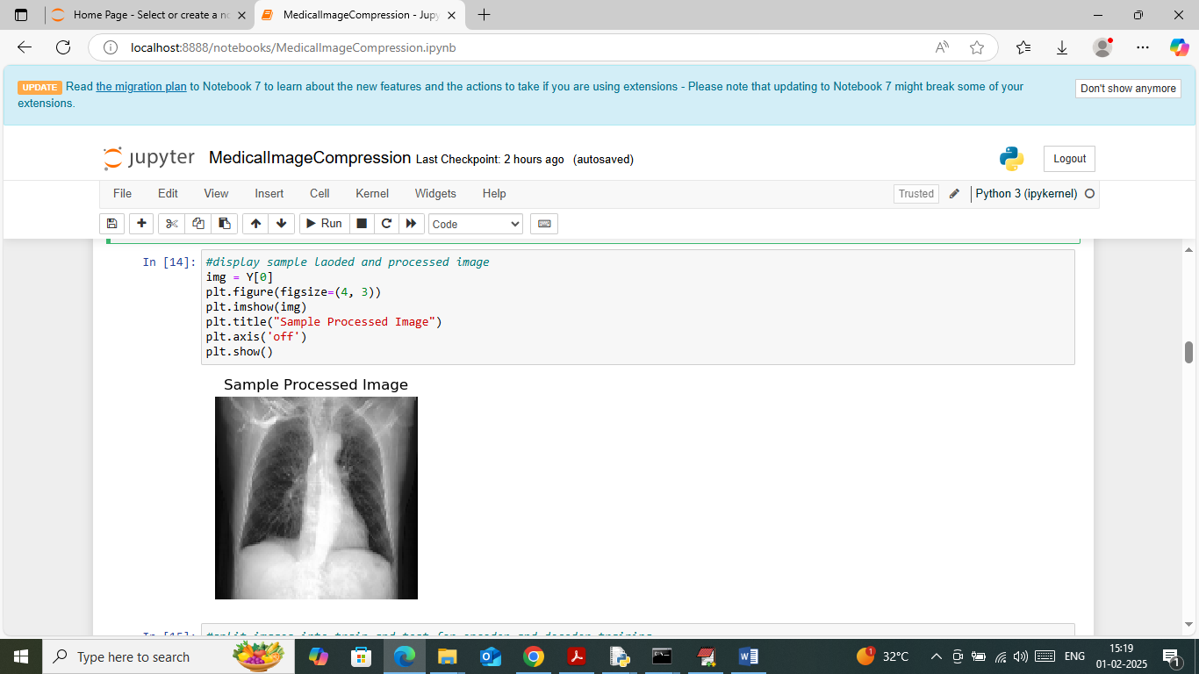
SCREENSHOTS

Slide 14
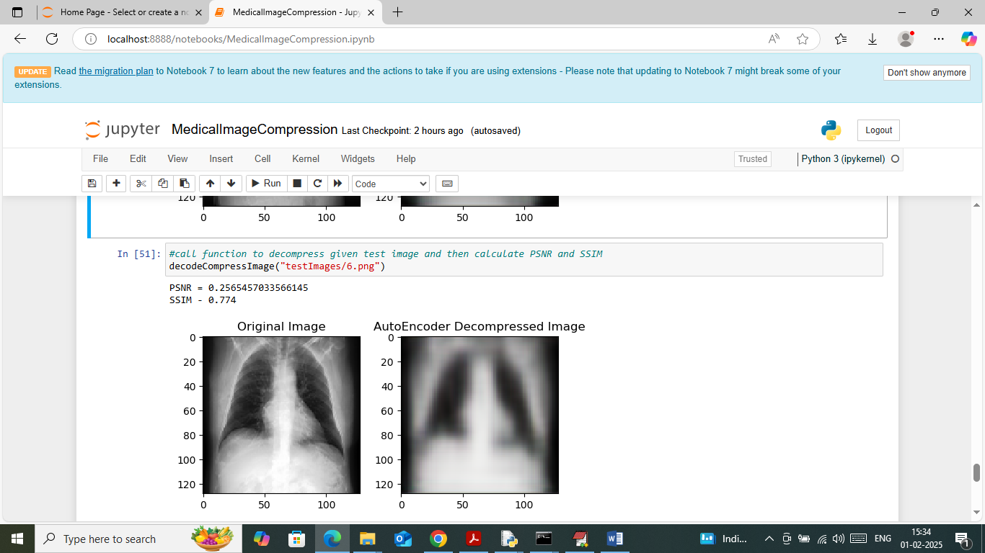

Slide 15
THANK YOU

